Slide 1
Search for the right library to do the job
Notes:
[Mandatory Slide] This would be the introduction slide of the topic that you are covering in this subsection.
When this slide plays, you could talk about the main aim that we’d be covering in this video.

Slide 2
In this Video, we are going to take a look at…
Defining the scope of your problem
Where to search for libraries?
How to assess and compare libraries
Notes:
[Mandatory Slide]
Before the start of the video, we’d like to highlight what are important topics or pointers that we’d be covering in this video. This slide would immediately follow the intro/name slide. This would just be say 2-3 points for the viewers to know what they are getting into.

Slide 3
Define the scope of a coding issue
Top-down functional decomposition: break your bigger problem down into smaller subtasks that can be addressed by libraries
Steps
choose and install the right libraries
write the liaising code between library calls
code what cannot be solved by libraries (your business logic)
Notes:
This slide can also be used to cover topics that can be represented by an image/graph etc. Information which is half image/half information type. Like shown in the example above.

Slide 4

Where to search for libraries?
The local Python standard library
Python libraries, especially

Slide 5
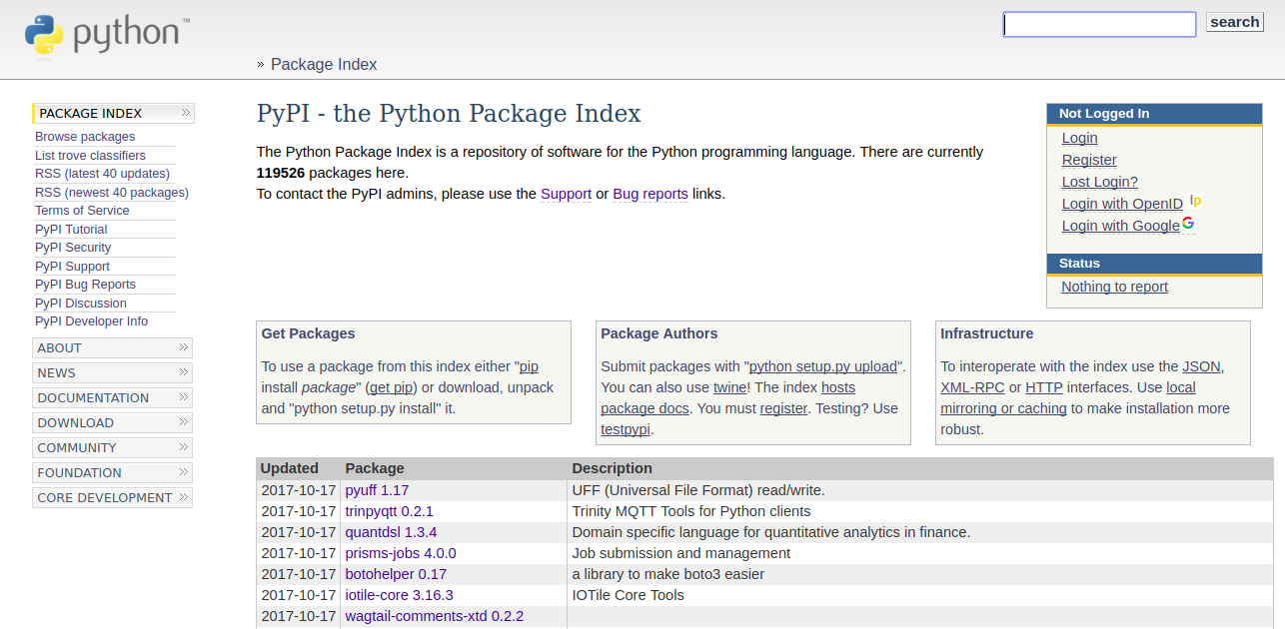
Where to search for libraries?
The local Python standard library
Use Pip to search the Python Package Index (https://pypi.python.org/pypi)
Python libraries, especially

Slide 6

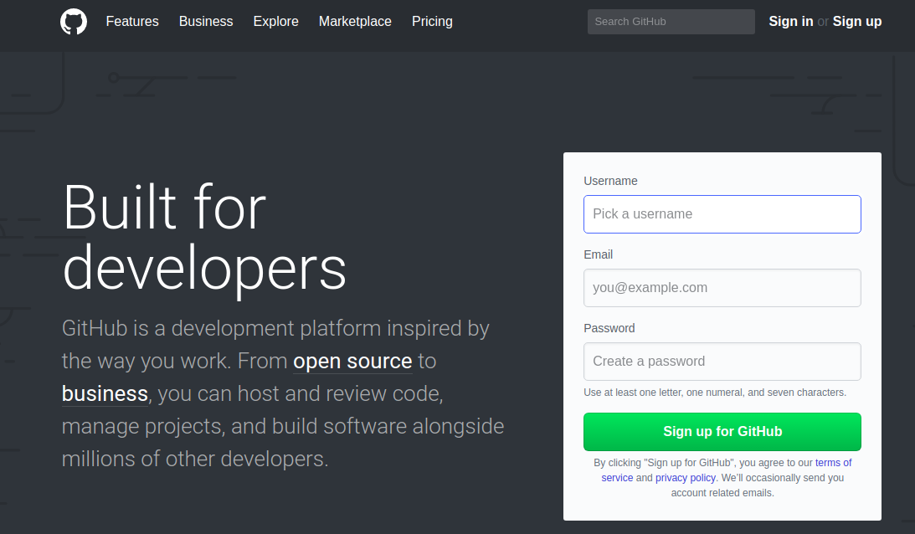
Where to search for libraries?
The local Python standard library
Use Pip to search the Python Package Index (https://pypi.python.org/pypi)
Social coding websites such as GitHub, BitBucket, SourceForge, ...
Python libraries, especially

Slide 7
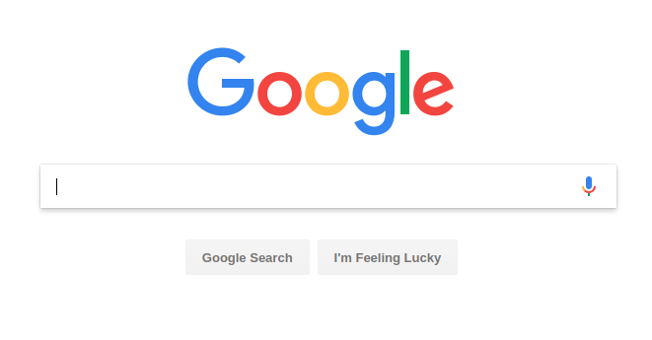
And when you run out of ideas….
Notes:
[Mandatory Slide]
Before the start of the video, we’d like to highlight what are important topics or pointers that we’d be covering in this video. This slide would immediately follow the intro/name slide. This would just be say 2-3 points for the viewers to know what they are getting into.

Slide 8
What if you
find multiple libs that do the job?
You should assess the following points on each library:
Number of known bugs/issues
Documentation
Testing coverage
Community activity
Potential security flaws
Dependencies
Performance
Ease of install
Size
…
How to compare them?

Slide 9
Summary
How to define boundaries for a problem
What channels to use to search for libraries
How to compare libraries and choose the best one for the job
Notes:
This slide, like mentioned is to summarize the various videos we have seen in this section. This gives the viewers a sense of achievement that they have covered exactly what they were looking for.

Slide 10
Using Pip to install libraries
Next Video
Notes:
[Mandatory Slide]
Here the name of the next video needs to be mentioned. The narration as you guessed it would be just letting the viewer know exactly where we are at and what we’d be taking over next! ☺

